Slide 1



The impact of inflammatory rheumatic diseases (such as arthritis and lupus) on transitions to motherhood: The STAR Family study
Aimee Grant, Denitza Williams, Bethan Pell, Helen Stanton, Rhiannon Phillips on behalf of the STAR Family study team

Slide 2



Acknowledgements
Participants
PPI group and online chronic pain panel
STAR Family study team:
  PI: Dr Rhiannon Phillips
  Study manager: Dr Denitza Williams
  Research Assistant: Ms Bethan Pell
  Research Assistant: Mr Daniel Bowen
  Research Assistant: Ms Helen Stanton
  Qualitative lead: Dr Aimee Grant
  Prof Adrian Edwards
  Prof Ernest Choy
  Dr Ann Taylor
  Dr Julia Sanders

Slide 3

Overview
Rheumatic diseases
Interventions to support family planning and breastfeeding in women with rheumatic diseases
Our study
  Methods
  Pre-conception
  Pregnancy
  After birth
  Stakeholder validation
Next steps

Slide 4
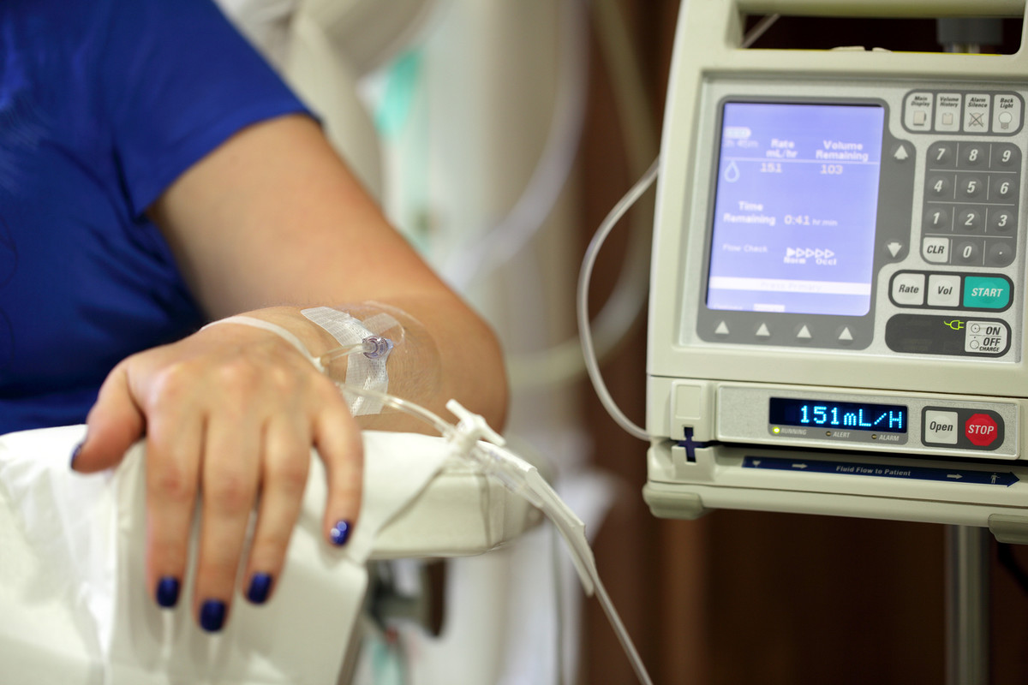
What are rheumatic diseases (RDs)?
Include: inflammatory arthritis, Lupus, vasculitis
May affect muscles, joints and other organs
  Pain is a major issue
  Many patients experience kidney issues
  The disease is not stable – flare ups
Commonly need to take medication
  Some of this is highly toxic
  Some toxic drugs are taken long term

Slide 5
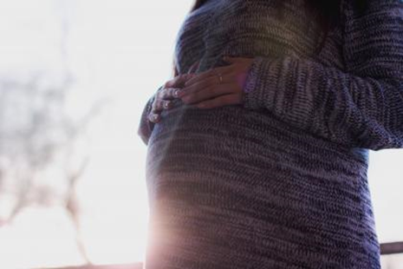
Women of child bearing age and RDs
25,000 women of childbearing age (16-49 years) in the UK with Rheumatoid Arthritis or Lupus
Range of issues:
  Fertility
  timing of pregnancy
  medication use; “clean” period
  mental health and physical functioning
Women with RD struggle to find enough
information about family planning,
pregnancy and early parenting (Ackerman et al. 2015)

Slide 6
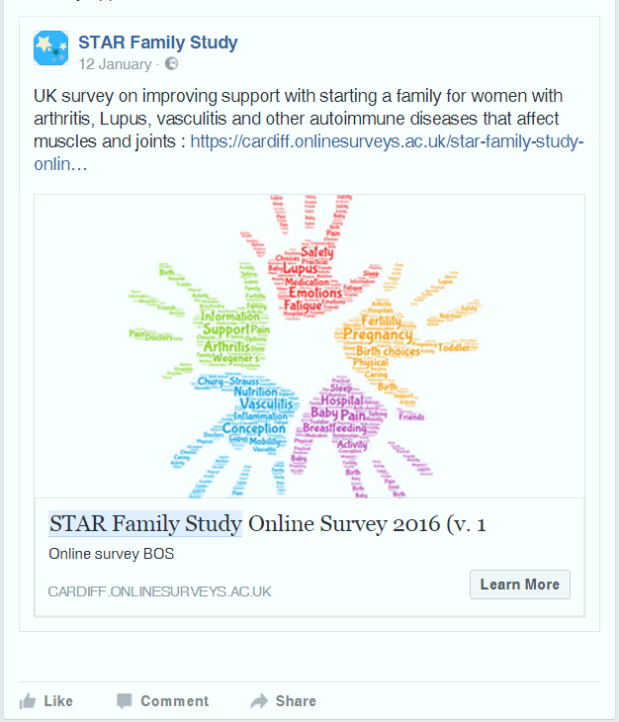
Methods
Online survey
  women from UK who have RD and thinking of getting pregnant/pregnant/had child in past 5 years (n=128)
  Recruitment via targeted adverts on social media
  open and closed questions
Timeline facilitated interviews (Sheridan, 2011)
  Women from survey (n=20)
    Completed timeline in advance of interview
Thematic analysis
  Early thoughts

Slide 7
Pre-pregnancy
Use of medication; active planning with health professionals
  they said that I needed, if I wanted to think about starting a family I’d have to go and have some …more chemo treatment, but I wouldn’t then be able to conceive for a good year, because of kind of the drugs inside you and it needed to all come out. And it was a bit of a bombshell really because then I think because I’d got so blasé and it was like yeah we’re married, we want to start having a family, why can’t it just happen?
Concerns about fertility
  Potential use of IVF
  I was in and out of hospital a lot over that period and they talked again, or they talked then about freezing my eggs so I was a 21, 20 year old kind of girl, hadn’t really thought about kind of babies and a future but they talked about it, but then that was it. We didn’t mention it again because of all the chemo drugs they were worried that that was going to be affected quite heavily but I think because it was so bad and they’d given me this five years to live actually getting the treatment in me was more important than thinking about the future.
Concerns about flare ups in pregnancy
(The consultant said): “I can’t do anything now, not that I can’t do anything but we need to make sure that you’re in kind of tiptop condition before.”

Slide 8
Pregnancy
Miscarriage and loss
I am still so grateful that she was born and she was part of our lives, she was with us for five days and we, they allowed us to stay in the neonatal unit for those whole five days and [my husband]. And we had her christened, we kind of I did a bit of random expressing of milk and we changed her nappies…
Successful pregnancies associated with luck and loss
  Yes it is but it’s, I am very very grateful for my two children because there’s a lot of people who really suffer and suffer many miscarriages and stuff whereas I have only suffered one miscarriage in my life, a lot of people have suffered a lot worse and haven’t been able to have children or have had their fertility robbed because of the medications they’ve been on and stuff. (mother)
Increased monitoring and intervention
I can’t praise the NHS enough
  But disjointed between maternity and rheumatology
Disease management
  Everybody just kind of said…women tend to go one of two ways so either completely symptom free during their pregnancy or they’re horrendously ill. (mother)

Slide 9
(early) Motherhood
Increase in disease activity
Infant feeding
  Harder to breastfeed
    Lack of physical support for breastfeeding
    lack of support for formula feeding
  Tension between ‘best for baby’ and treating disease
  Lack of sensitivity when feeding wasn’t going well
  So we got discharged, we came home and then on the Monday we had this other midwife come to see us and she’d gone to 15% (weight loss) which still in our minds, because she was so, such a good weight but obviously something is not working because she’s not taking…she’s not putting on weight so she’s not being stable, this midwife then made us feel absolutely horrendous and made out that [Child 2] was going to die. She then kind of on Day 7 where we’d lost [Child 1] on Day 5 she was like no, if this child doesn’t get fed she is going to die.
Adoption
  Discrimination from health professionals – 1.5 years

Slide 10
Impact of RD on family planning
Centrality of the unknown
  Passive, low sense of self-control
Conflict between patient role and maternal identity
Inaccessibility of motherhood: in relationships and when single
The health service do not always consider this holistically
There is a need for more support and information for women with RD when they are of child-bearing age

Slide 11
References
Ackerman IN, Ngian G-S, Van Doornum S, Briggs AM. (2016) A systematic review of interventions to improve knowledge and self-management skills concerning contraception, pregnancy and breastfeeding in people with rheumatoid arthritis. Clinical Rheumatology. 35(1):33-41.
Sheridan, J., Chamberlain, K., & Dupuis, A. (2011). Timelining: Visualizing Experience. Qualitative Research, 11(5), 552–569. https://doi.org/10.1177/1468794111413235

Slide 12





Thank you
Any Questions?
@CTRCardiffUni
@DrAimeeGrant
@denitzawilliams
@BethanPell
@nannon_philips

