Slide 1
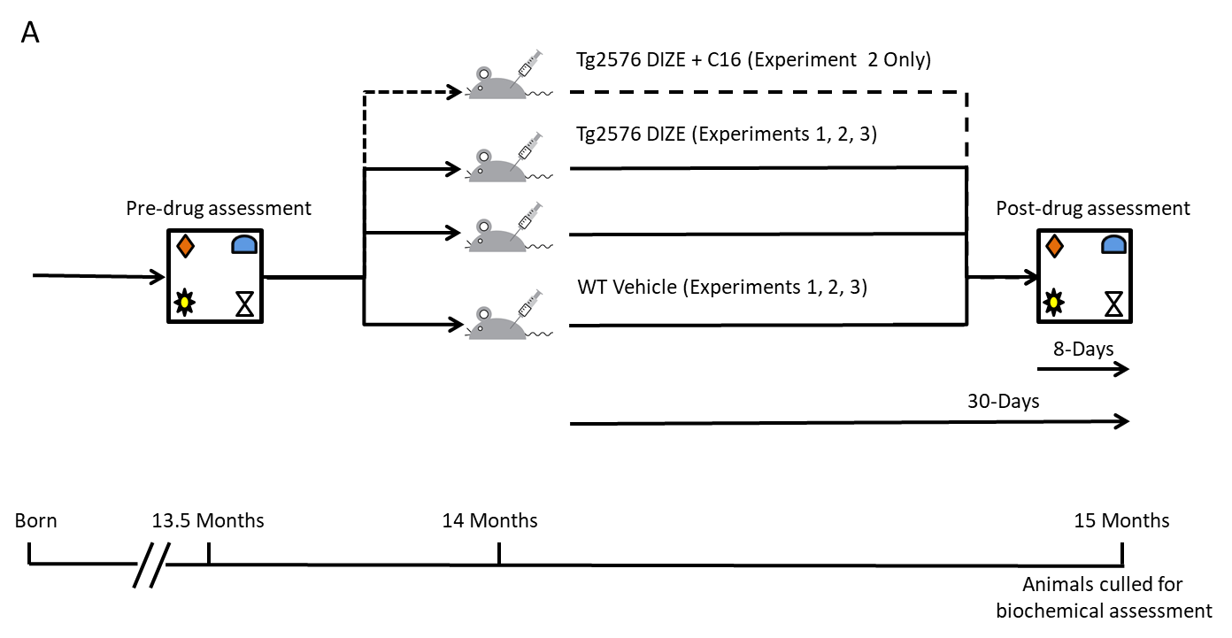
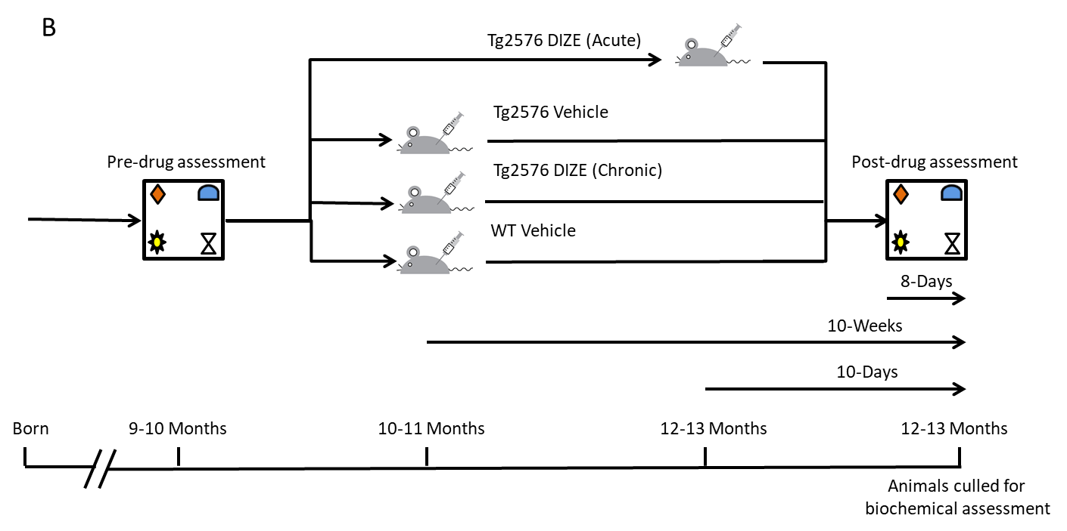
Figure 1
a
b

Slide 2
b
e
a
*
c
*
f
*
#
d
*
Notes:
Figure 2. Improved associative recognition memory performance and reduced amyloid pathology in Tg2576 mice administered DIZE is associated with increased ACE2 activity. (A) Following 30-days DIZE administration, associative recognition memory, tested using the Object in Place (OiP) task, was significantly improved in Tg-DIZE mice (n=9) compared to pre-DIZE scores (+++p<0.001). Tg DIZE mice also performed significantly better than Tg-vehicle mice (###p<0.001; n=11). Tg-vehicle mice also remained impaired compared to WT-vehicle mice (***p<0.001; n=12), whilst Tg-DIZE mice showed a comparable performance level to WT mice, p>0.1. (C-E) Hippocampal insoluble Aβ40, 42 and 43 concentration, measured by ELISA. Aβ42 and Aβ43 were significantly reduced in Tg-DIZE mice (F; *p<0.05). (F) Hippocampal ACE2 level measured by ELISA was lower in Tg-Vehicle compared to WT-vehicle mice (p*<0.05) but no difference was observed between WT- and Tg-vehicle mice (p’s>0.05). (G) Hippocampal ACE2 activity, quantified using a FRET enzyme activity assay, showed increased ACE2 activity in the hippocampus of Tg2576 mice administered DIZE compared to WT-vehicle (*p<0.05) and Tg-vehicle (p#<0.05). Behavioral data was analyzed using Mixed Measures ANOVA. Significant interactions were further analysed by tests for simple main effects with Bonferroni corrections for multiple comparisons. ACE2 analysis was performed using One-Way ANOVA with post-hoc Tukey analysis. Amyloid analysis was performed using independent-samples t-test. Error bars represent the standard error of the mean (SEM).
***Numbers in each cohort missing*** - Added. For A. The numbers should be consistent across the remaining analysis in this figure.

Slide 3
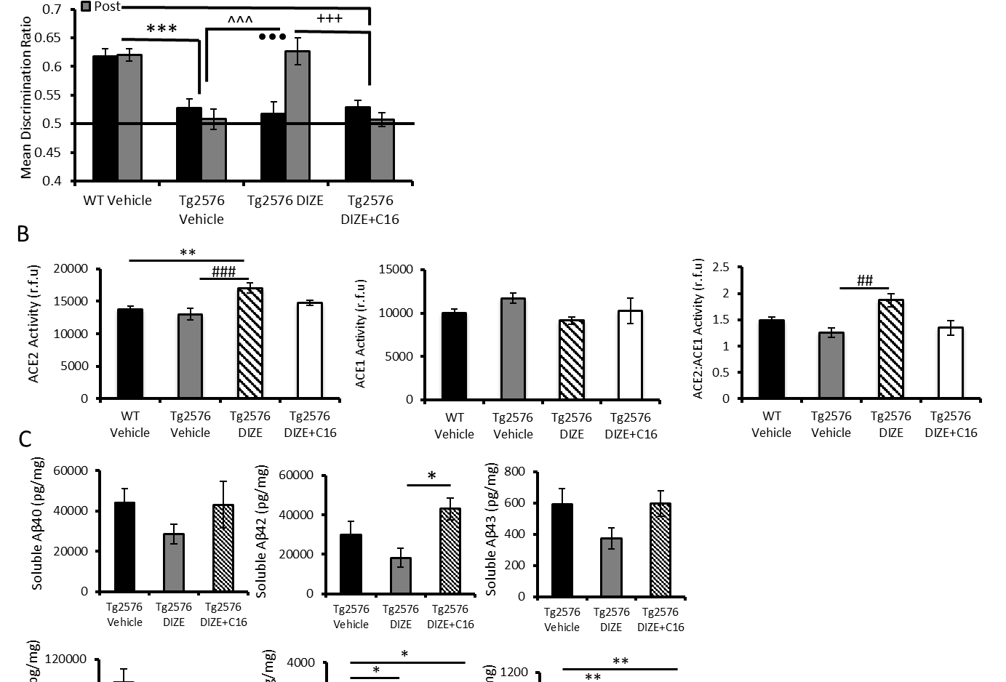
a
Figure 3
b
c
Notes:
Figure 3

Slide 4
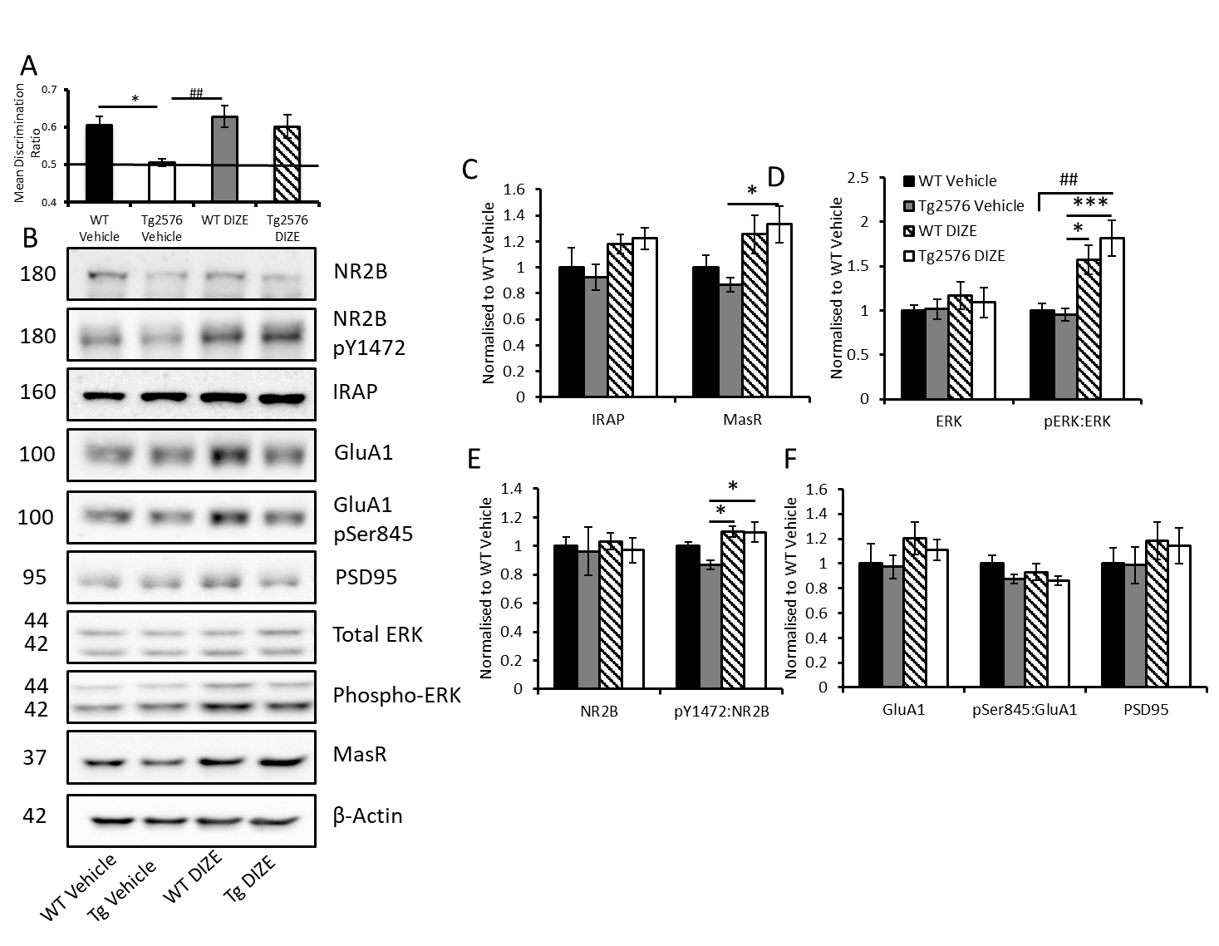
a
Figure 4
c
d
b
e
f
Notes:
Figure 4

Slide 5
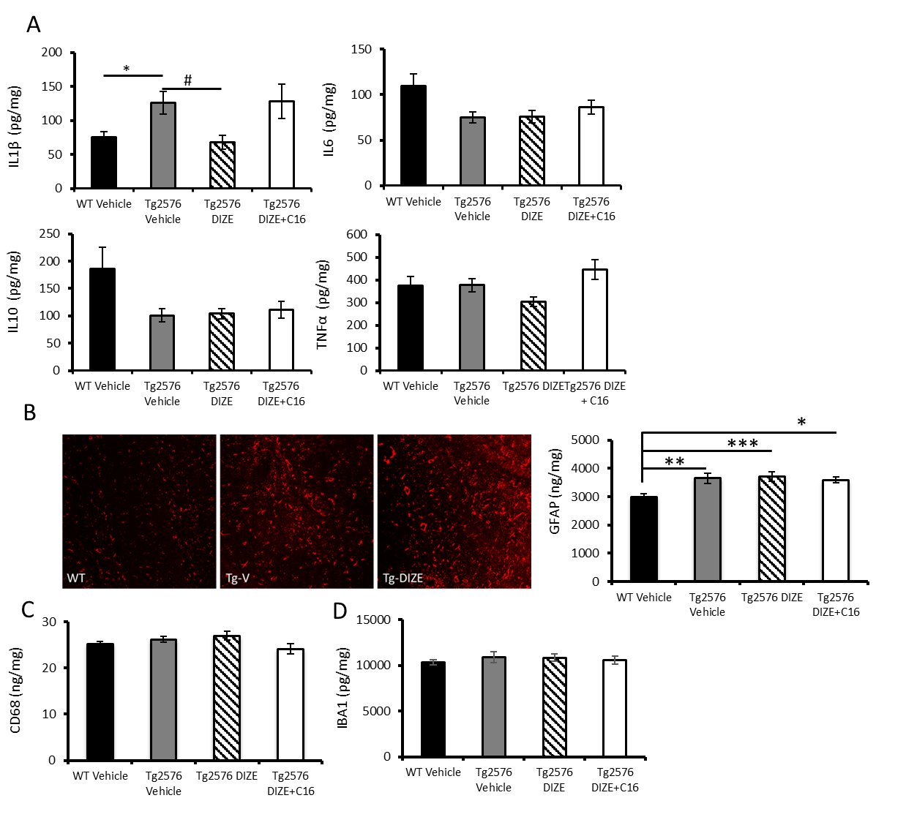
Figure 5
a
b
c
d
Notes:
Figure 5

Slide 6
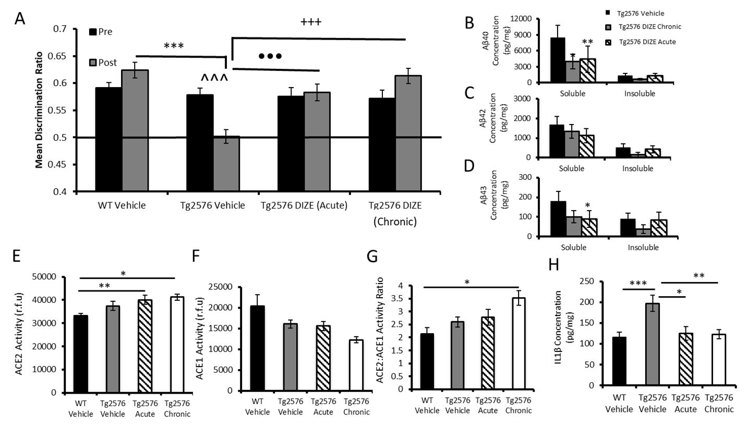
Figure 6
a
b
*
c
d
e
f
g
h
Notes:
Figure 6.

