Slide 1

ATLAAS - Investigation into the incorporation of Morphological Data on Automated Segmentation
Presenter: Craig Parkinson

Slide 2
EANM Disclosure Statement
1) I or one of my co-authors hold a position as an employee, consultant, assessor or advisor for a pharmaceutical, device or biotechnology company. If yes, please specify name/position/company:
Not applicable
2) I or one of my co-authors receive support from a pharmaceutical, device or biotechnology company. If yes, please specify name/position/company/which project and whether support is in kind or monetary:
Not applicable
3) I or one of my co-authors hold property rights/patents for (radio)pharmaceuticals, medical devices or medical consulting firms. If yes, please specify name/position/company:
Not applicable
4) I or one of my co-authors have written articles for (radio)pharmaceutical, medical device, biotechnology or consulting companies during the last 5 years. If yes, please specify name/position/company/article/ journal and co-authors:
Not applicable

Slide 3

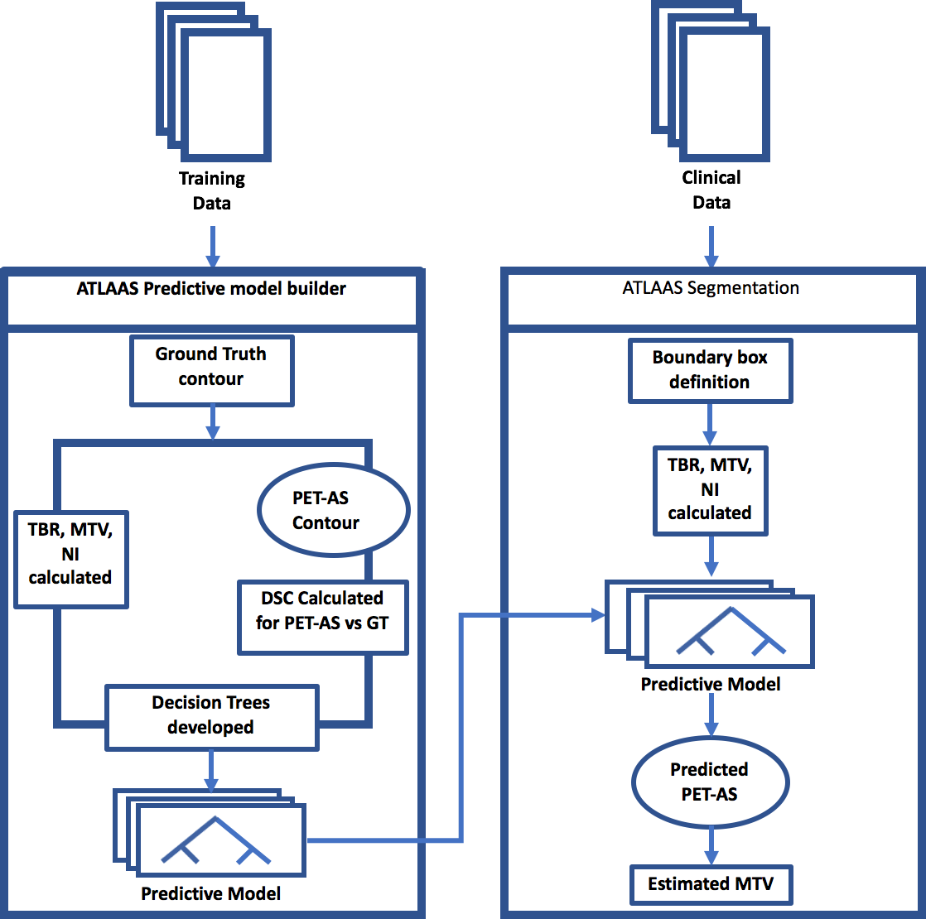
Training dataset of 211 ¹⁸F-FDG PET scans (260 volumes)
Develops decision trees for 7 PET-AS methods
Incorporates tumour, PET and radiomic features MTV, TBR and NI in decision tree development
Selects one of the included PET-AS methods to delineated the MTV
Berthon et al, 2016, Phys. Med. Biol., vol. 61, pp. 4855
Berthon et al, 2017, Radiother Oncol, pp. 242
Foley et al, 2018, Eur Radiol, pp. 428
Parkinson et al, ESTRO 37, 2018

Slide 4
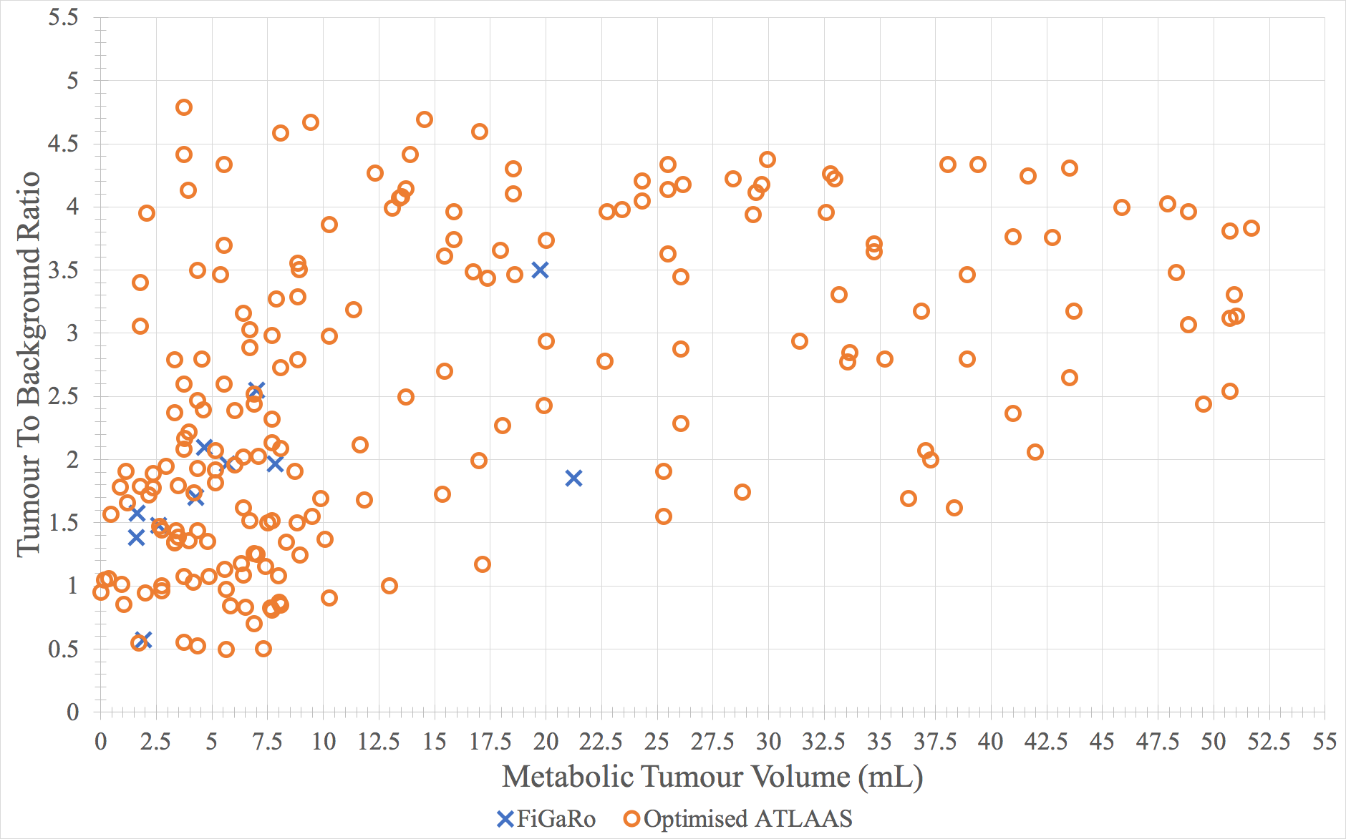
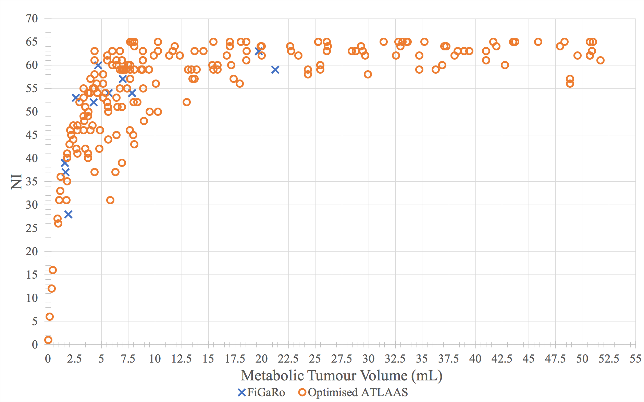
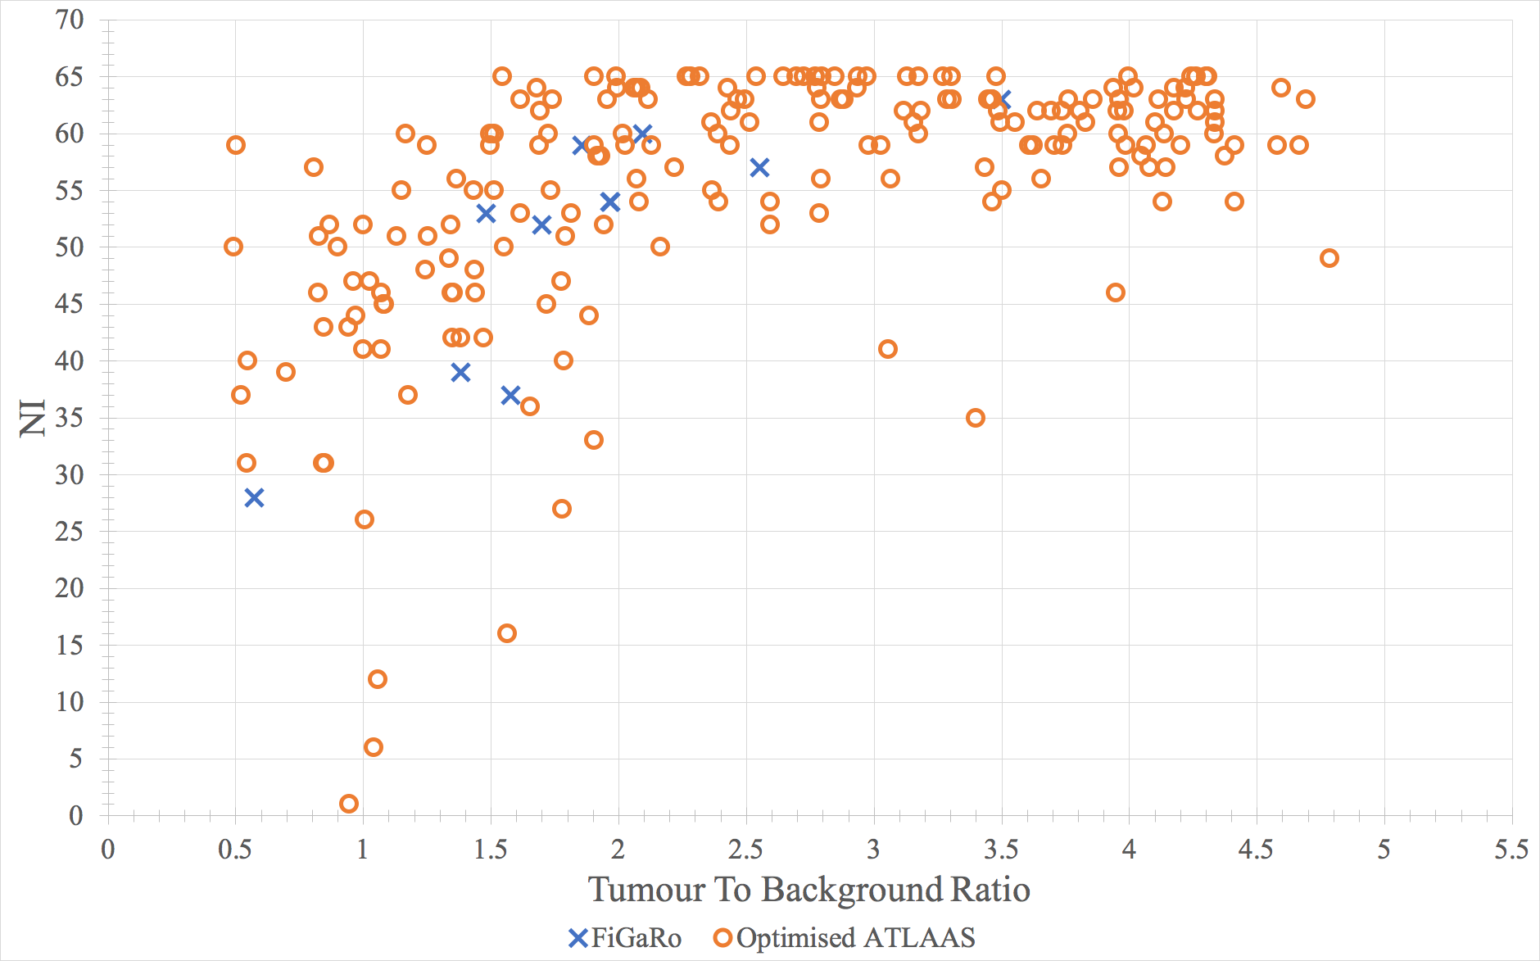
a)
b)
c)
a), b) and c) demonstrate the distribution of the training data parameters incorporated into the ATLAAS statistical model compared to clinically observed data

Slide 5
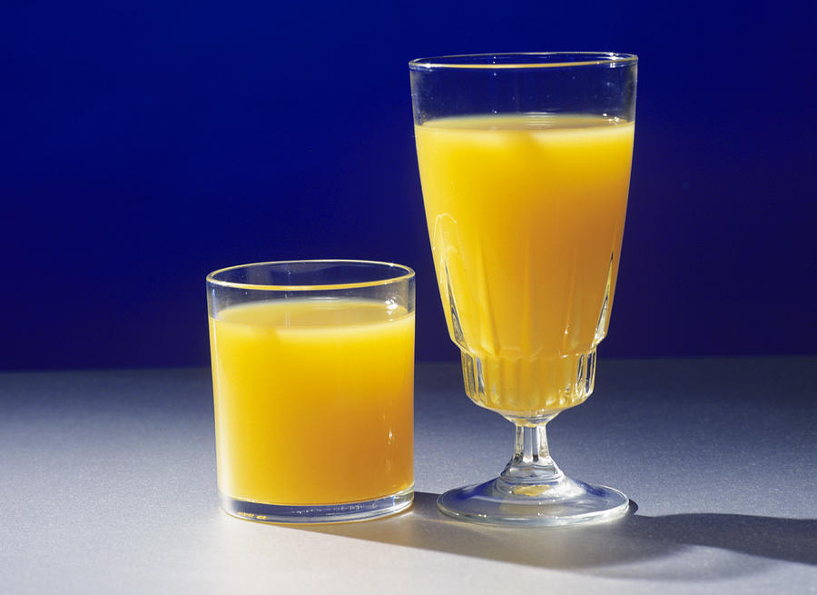
Why should we investigate Morphological features in training models?
Describe a tumour shape, which can describe how complex the tumour is
Therefore…
Including them in training models may improve the models accuracy
However…
PET has low spatial resolution

Slide 6
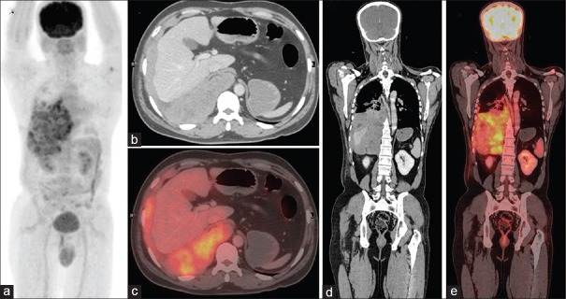
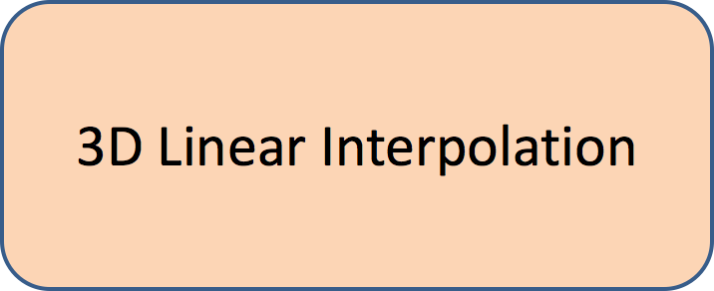
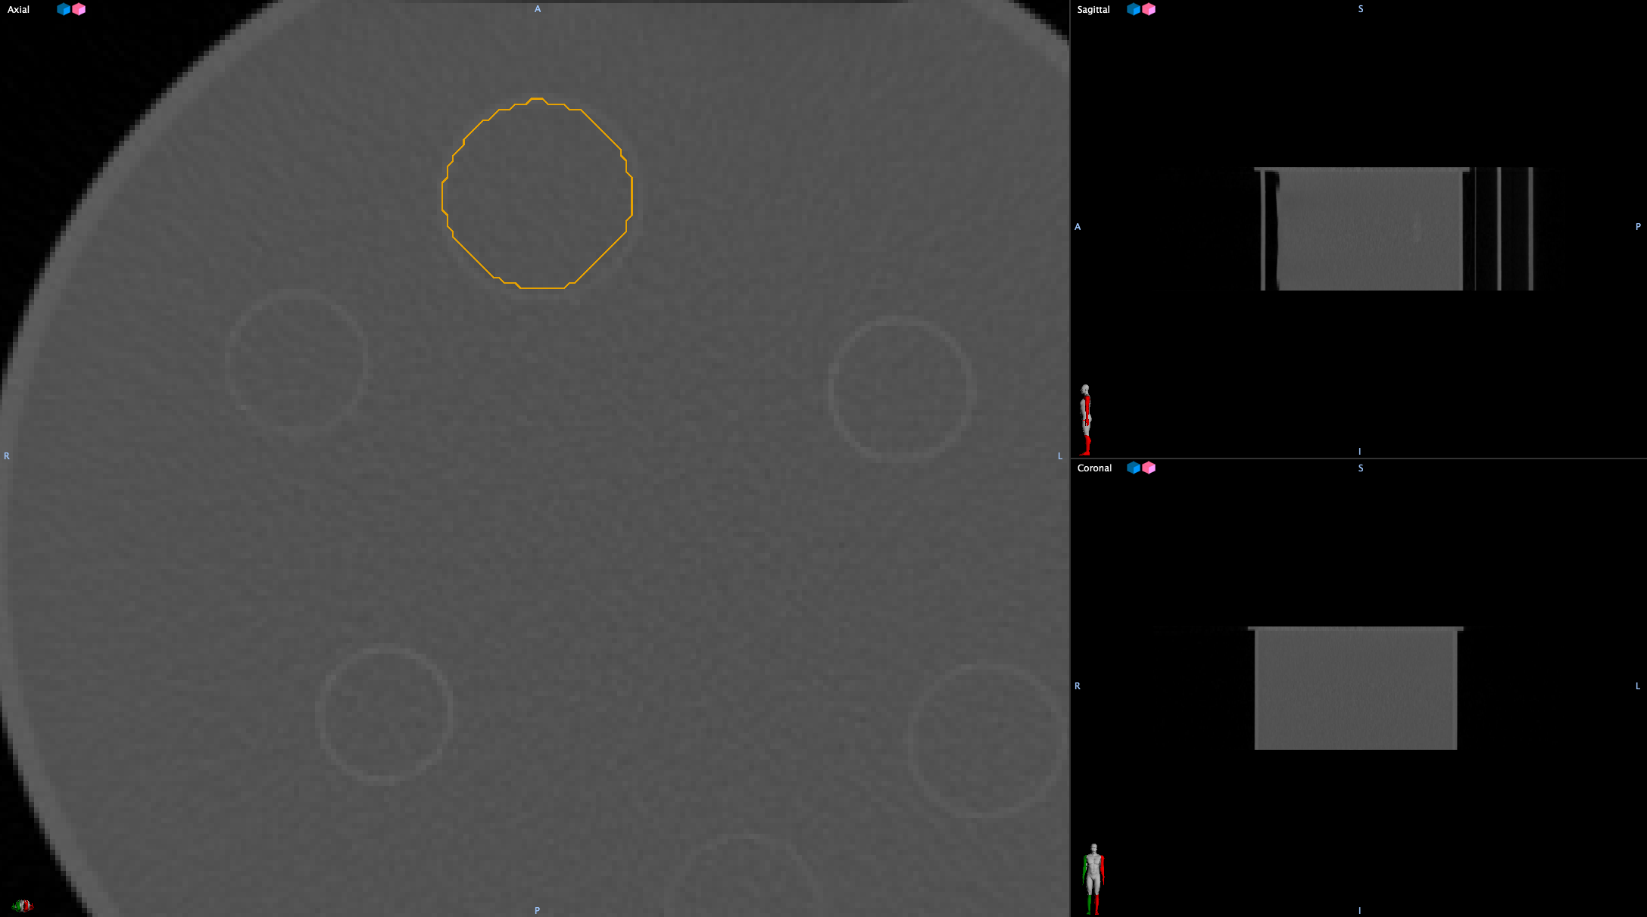
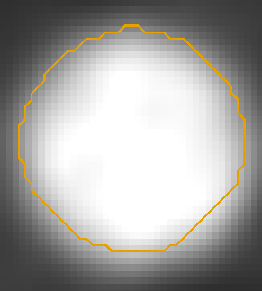
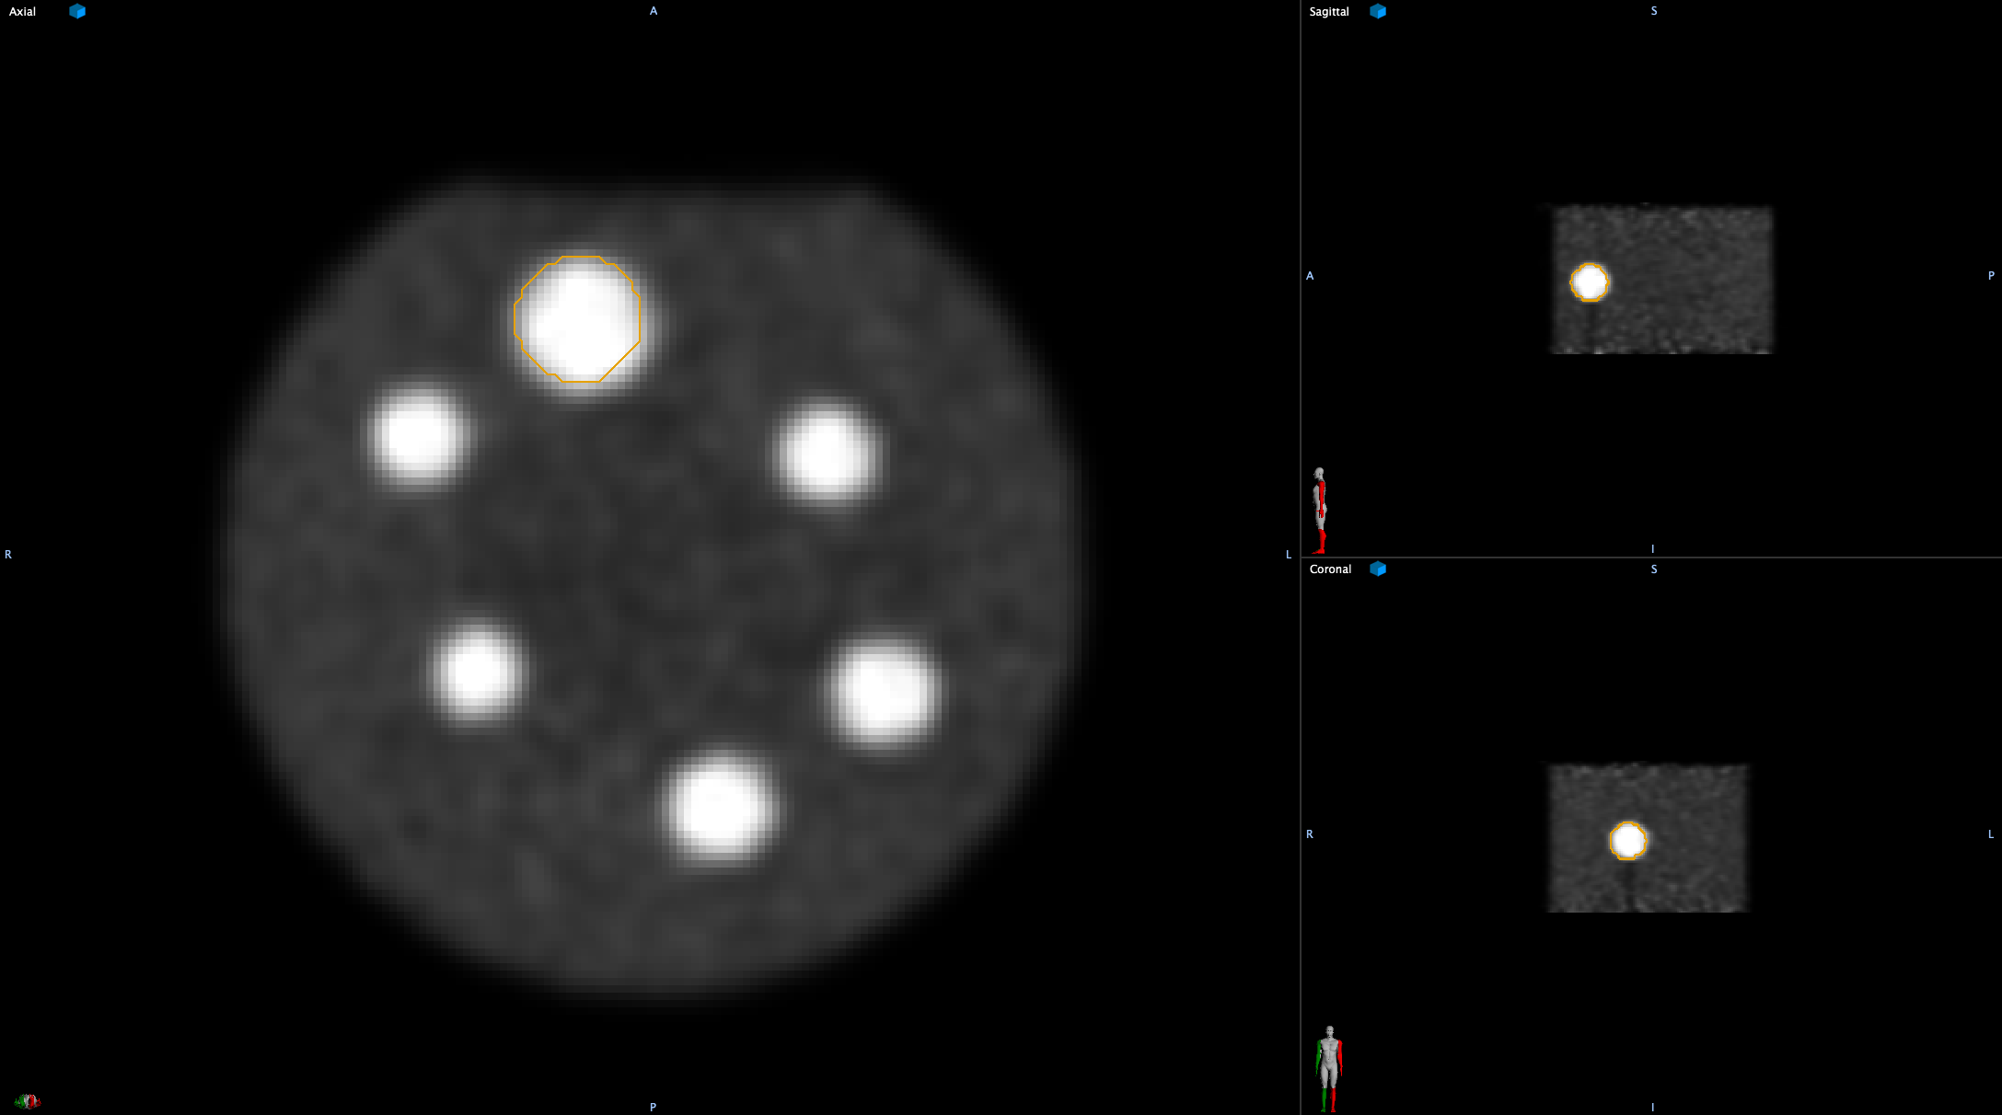
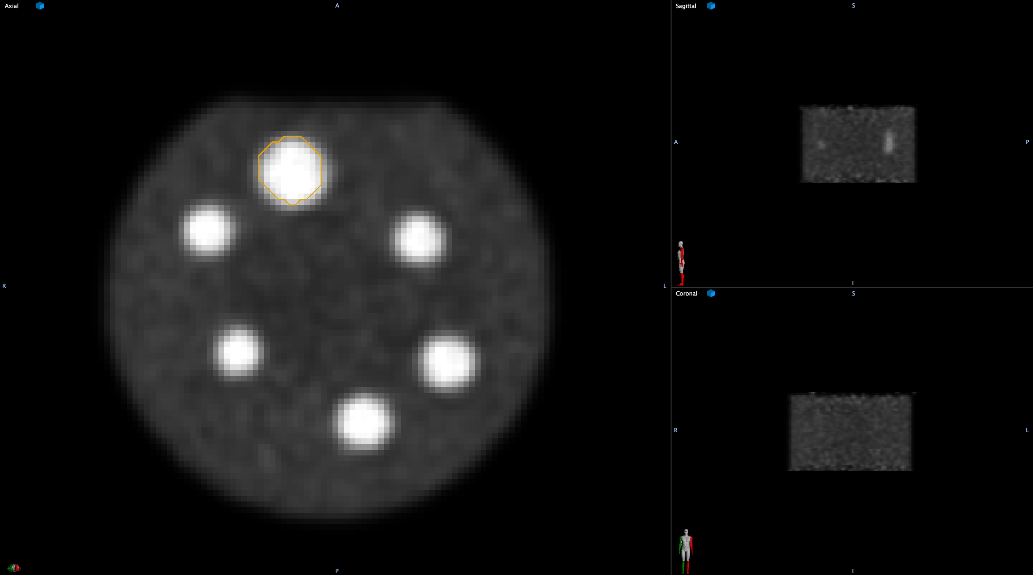
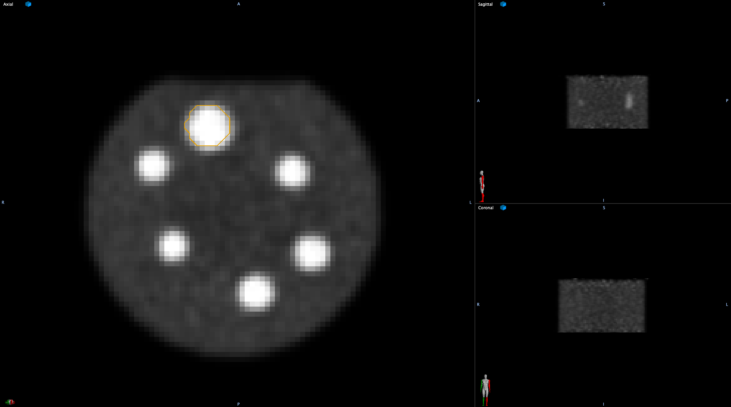
Interpolating PET imaging
Delineation on CT imaging with a 512 x 512 matrix and ~1 mm resolution allows for contours to follow anatomical borders
PET imaging with a 256 x 256 matrix and ~3 mm resolution potentially limits the performance of target delineation
a) CT phantom contour
e) PET 1x1x3 mm contour
d) PET 2x2x2 mm contour
c) PET 3x3x3 mm contour
b) PET
4x4x4 mm contour

Slide 7
Materials & Methods
Training dataset of 211 ¹⁸F-FDG PET scans (260 volumes)
22 Morphological features implemented using IBSI specifications (https://arxiv.org/abs/1612.07003)
Validation Dataset consisting of 96 simulated & phantom ¹⁸F-FDG PET volumes including tori, spheroids & complex geometries
Interpolated Training dataset to 4 spatial resolutions
  4x4x4 mm voxel dimensions
  3x3x3 mm voxel dimensions
  2x2x2 mm voxel dimensions
  1x1x3 mm voxel dimensions
Developed predictive models for each of the 22 IBSI morphological features on each training dataset (88 training datasets in total)

Slide 8
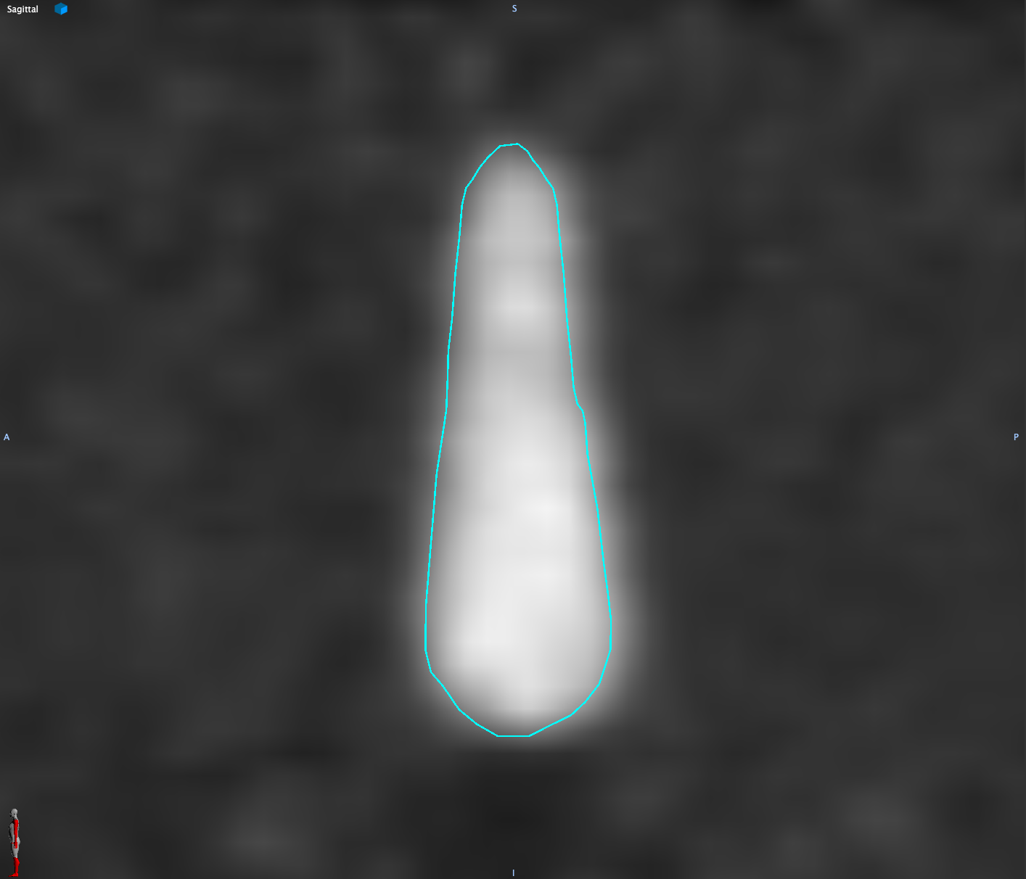
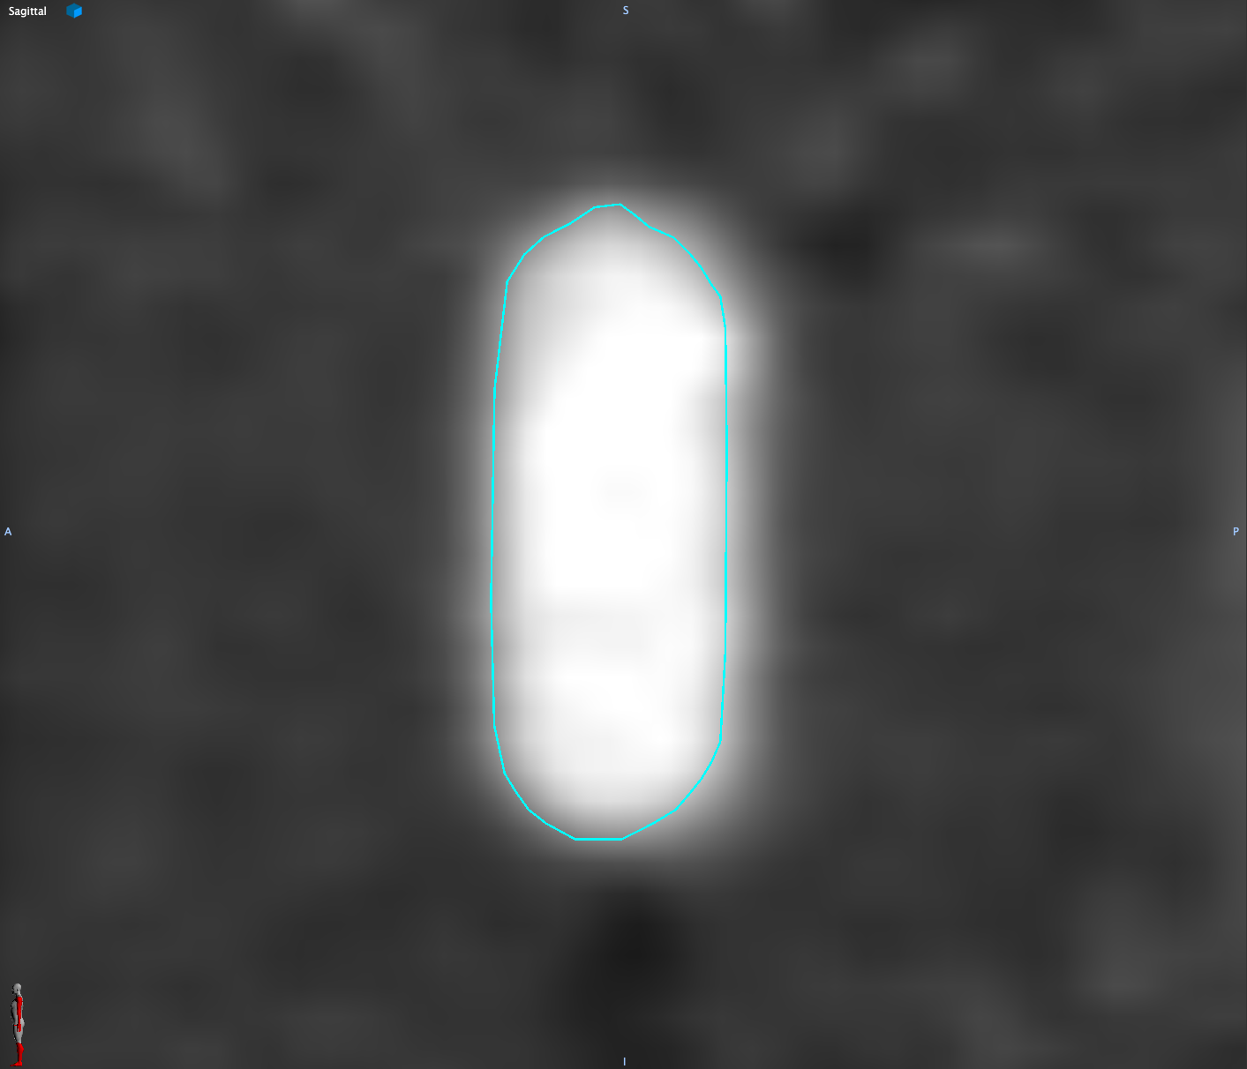
Materials & Methods Cont.
DSC calculated for each training dataset applied to its respective spatial resolution validation dataset compared to the 1 mm ground truth (GT) contour
Kruskal-Wallis used to check for significant difference in model performance on between contours derived on 4 mm, 3mm, 2 mm and 1 mm XY (3 mm Z) imaging against GT contour (P = 0.05)
One tailed, Mann Whitney U used to check for significant improvement between models with additional features
Pear ground truth contour
Tube ground truth contour

Slide 9
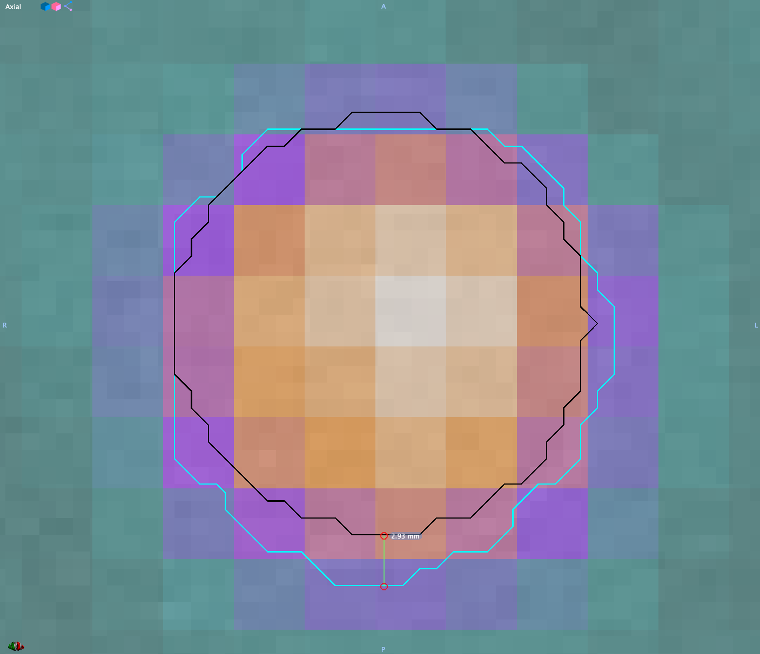
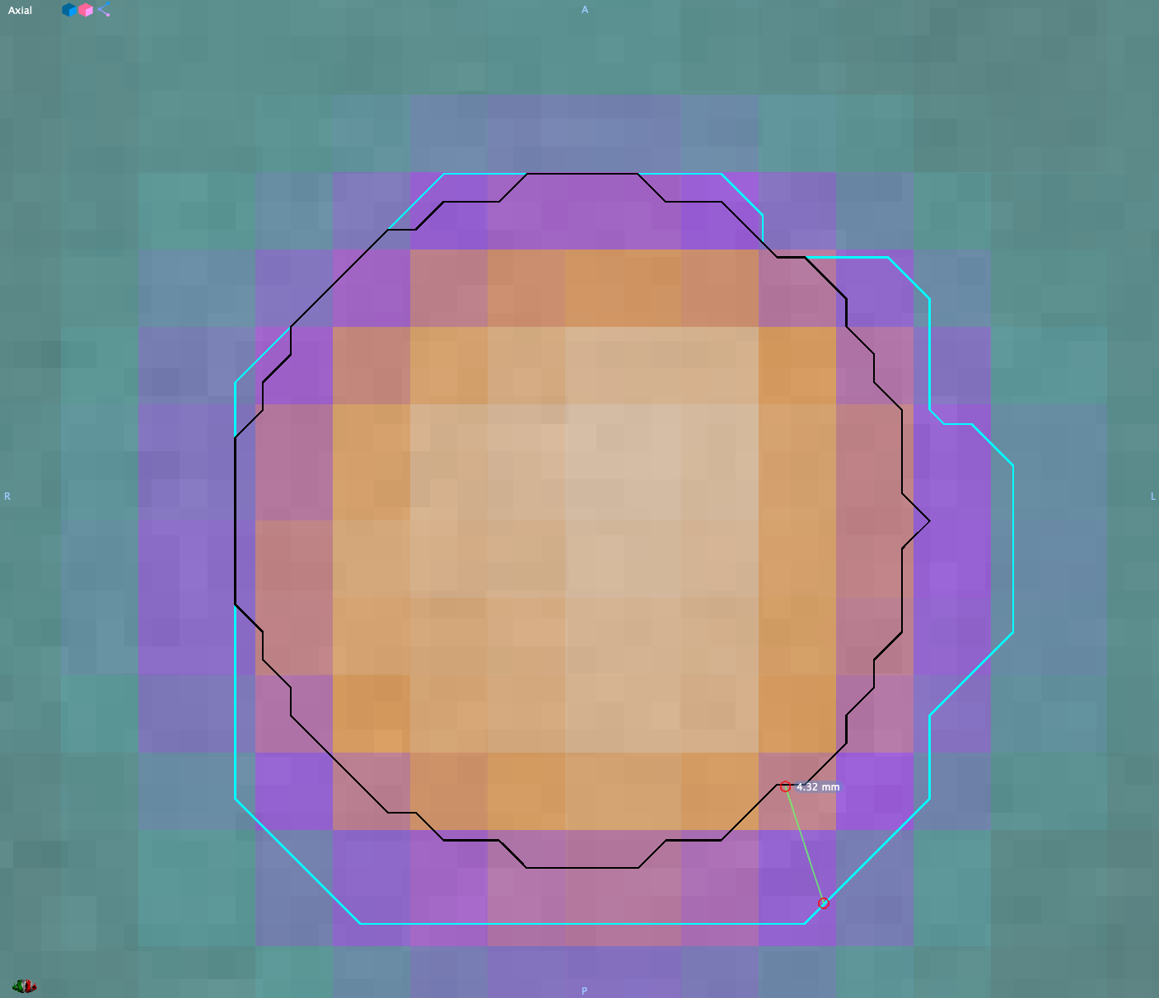
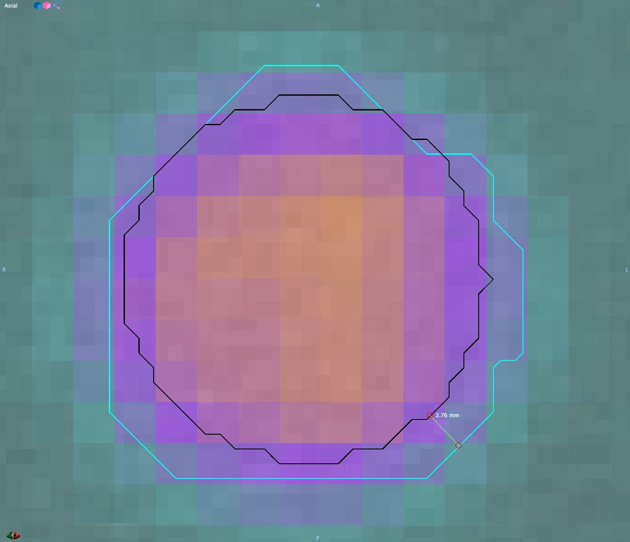
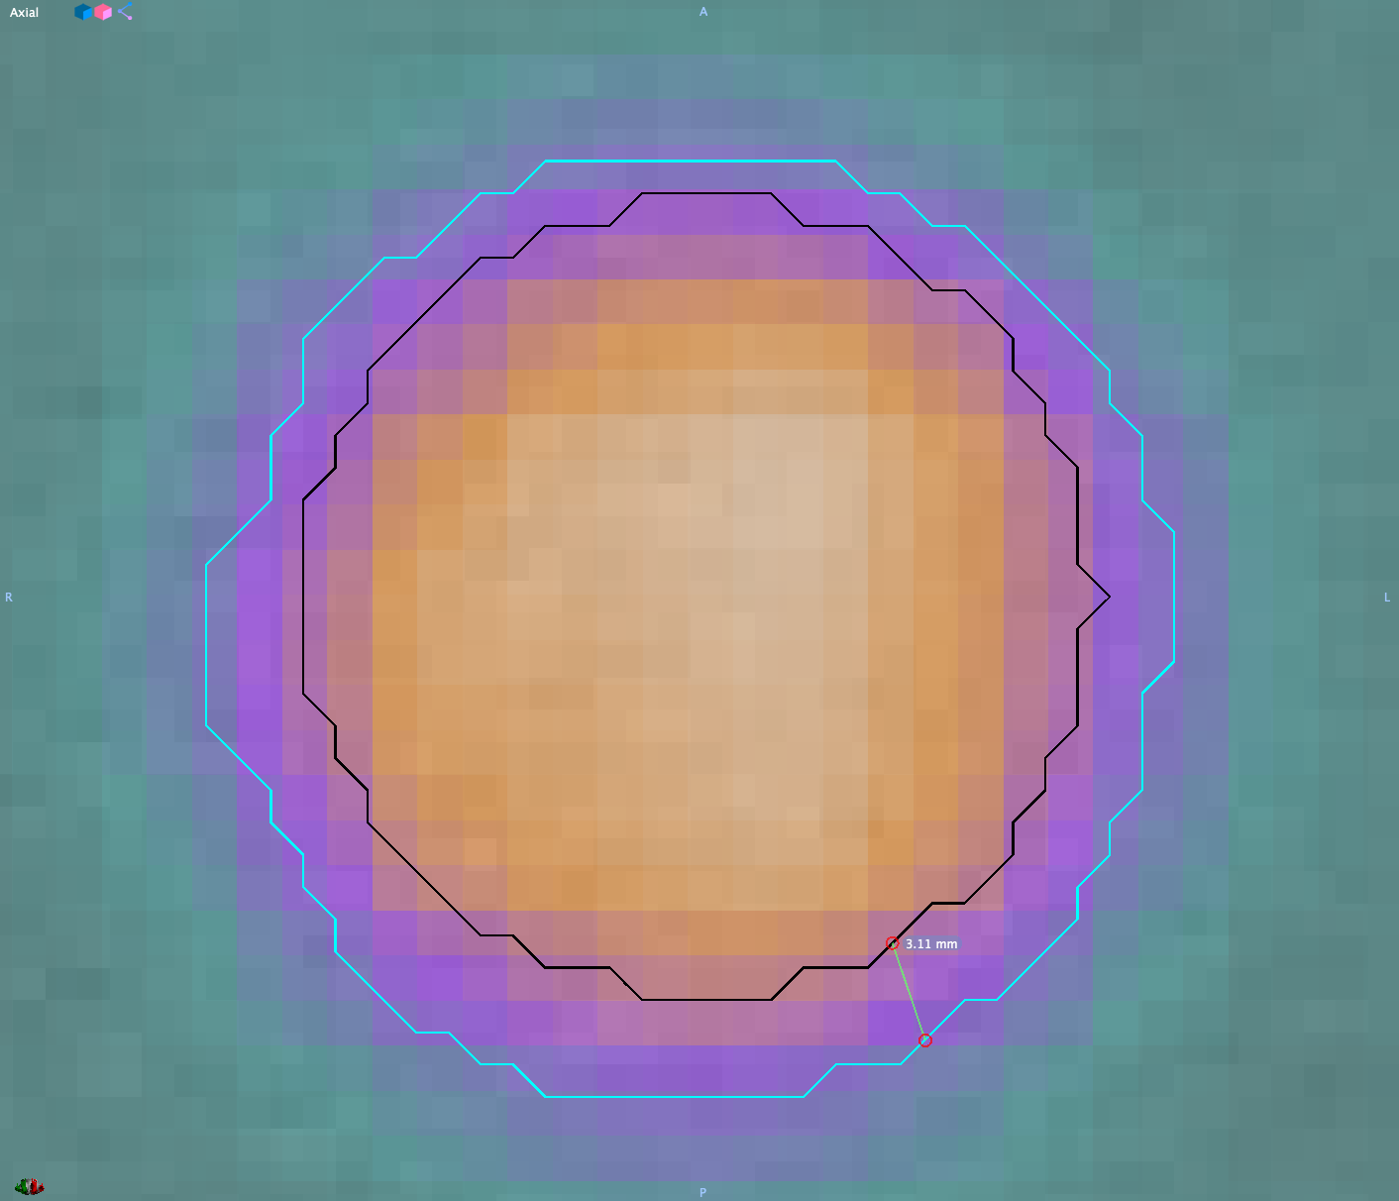
Contouring
4 mm PET
3 mm PET
GT in black on CT image
ATLAAS segmentation in turquoise on PET
2.93 mm
4.32 mm
2 mm PET
1 mm PET
2.76 mm
3.11 mm

Slide 10
ATLAAS training model with Volume (mL), NI and TBRpeak as parameters

Slide 11
Area Density
(Enclosing Ellipsoid)
Maximum 3D Diameter
Volume Density
(Axis Aligned)
Asphericity
Compactness 1
Elongation
Area Density
(Convex Hull)
Least Axis Length
Volume Density
(Convex Hull)
Compactness 2
S2VR
Flatness
Area Density
(Axis Aligned)
Minor Axis Length
Volume Density
(Enclosing Ellipsoid)
Integrated Intensity
COMShift
Sphericity
Major Axis Length
Spherical Disproportion
Surface Area

Slide 12
Conclusion
The spatial resolution of PET imaging influences the ATLAAS segmentation methodology accuracy, with higher-resolutions improving the DSC of the training model
Including additional morphological features in the predictive model may improve the accuracy of a predictive model. However, we found this was not statistically significant.

Slide 13

Acknowledgments
With thanks to
Phil Whybra
Prof Chris Marshall (PETIC)
Prof John Staffurth (Velindre Cancer Centre)
Dr Emiliano Spezi (Cardiff University and Velindre Cancer Centre)

Slide 14
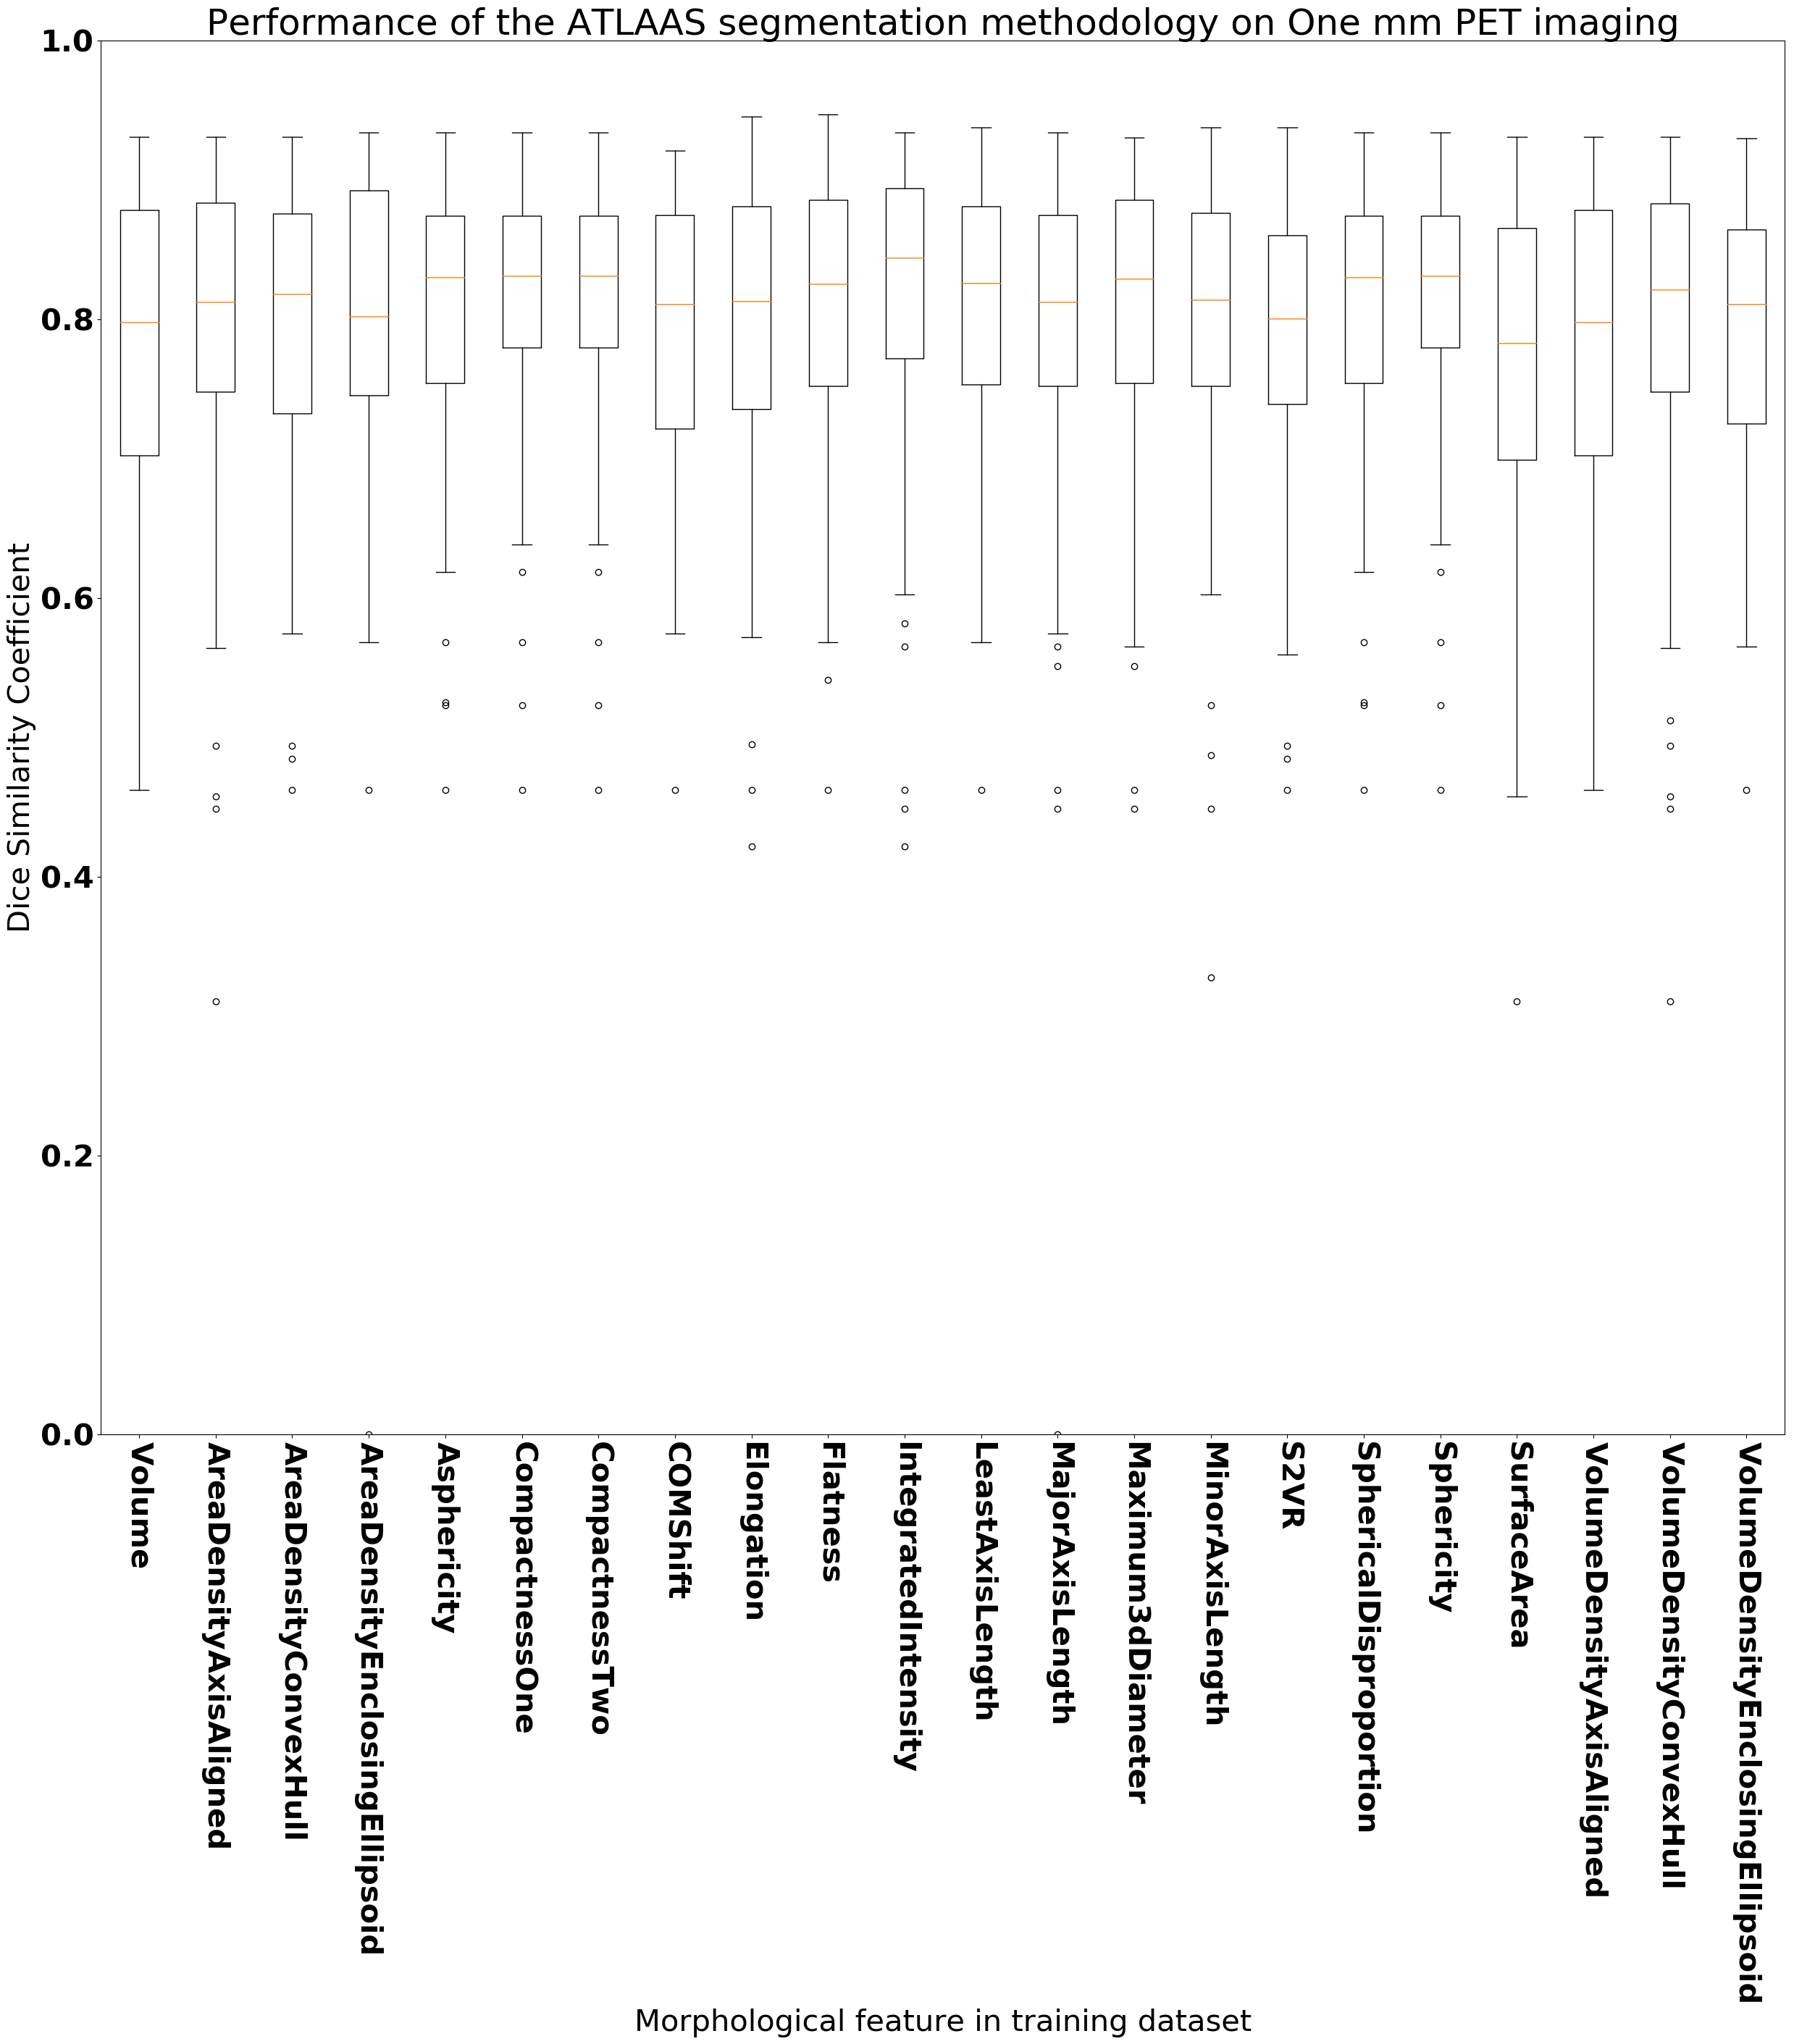
Including additional morphological features, improved 19 of the predictive models, with 9 models having a DSC > 0.8
Kruskal Wallis to check for significant difference in the 22 predictive models on 1 mm imaging
No significant difference at the 5% significance level (P = 0.29)
Compactness1, Compactness2 & Sphericity produced the same DSC results (0.81)

